Slide 1
Modeling Non-Equilibrium Plasmas
using AtomDB
Adam Foster
Hiroya Yamaguchi
Randall Smith
Nancy Brickhouse
Smithsonian Astrophysical Observatory
Li Ji
Purple Mountain Observatory
Tim Kallman
NASA Goddard
Joern Wilms
Universität Erlangen-Nürnberg
www.atomdb.org
afoster@cfa.harvard.edu

Slide 2
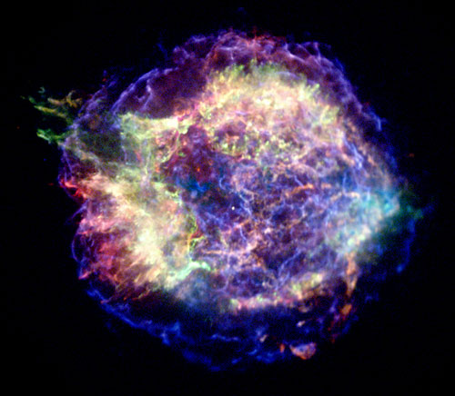
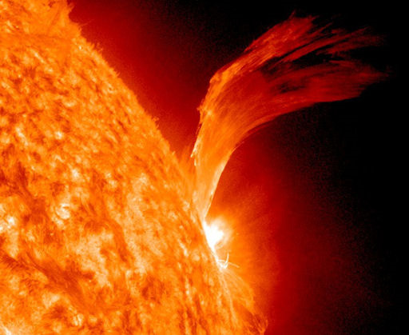
Where?
c
Cas A

Slide 3

Where?
c
Cas A
DS-1

Slide 4
What?
Ionizing shock rapidly heats electrons:
At t=0 At t=∞ (Ne*t > ~5x10¹²)
HOT electrons HOT(ish) electrons
NEUTRAL ions STRIPPED ions
→ Emission from unusual ions, and unusual lines

Slide 5
Inner Shell Processes
Fluorescence
Autoionization
Fluorescence Yield:
ω=Ar/(Ar+Aa)
Autoionization+

Slide 6
Modeling NEI emission

Slide 7
Modeling NEI
> xspec
XSPEC> model vnei
Borkowski+2001
Uses old AtomDB data (difficult to update)
Inner shell ionization from fits to experimental data
Uses Kaastra & Mewe 1993 for fluorescence yields
Only Kα, no Kβ.

Slide 8
New Model
Build in proper handling of autoionizing levels to AtomDB.
  Inner shell excitation
  Inner shell ionization
  Fluorescence
  Auger breakup
Include levels for Kβ, Kγ.

Slide 9
New Model
Build in proper handling of autoionizing levels to AtomDB.
  Inner shell excitation
  Inner shell ionization
  Fluorescence
  Auger breakup
Include levels for Kβ, Kγ.
}
Palmeri, Mendoza, Gorczyca, Hasoglu, etc

Slide 10
New Model
Build in proper handling of autoionizing levels to AtomDB.
  Inner shell excitation
  Inner shell ionization
  Fluorescence
  Auger breakup
Include levels for Kβ, Kγ.
}
??? et al.
}
Palmeri, Mendoza, Gorczyca, Hasoglu, more

Slide 11
Method
Large scale Flexible Atomic Code runs
All ions, all 12 most common elements
Fe data for L & K
shell ions from
Eriksen+ 2013

Slide 12
Why you Care
Corrected energies
Kβ

Slide 13
How to Use it
[Wait 1-2 weeks - sorry]
Necessary data has been generated
AtomDB code has been re-written
XSPEC/Sherpa models not finished
www.atomdb.org

